Slide 1
Remote Online Contact Manager
Group 6

Slide 2
Team Members and Role
Ikenna Acholonu-PM/JavaScript
Christopher Rodbourne-Javascript
Daniel Schiff-HTML
Tyler Cuervo-API
Greg Eugene-API
Suvrat Jain-Database
Alexander Meade-Database

Slide 3
Project Description
Stores contacts into database
Organize them alphabetically
Assigned userkeys to each contact
Restricts deletion access to userkey but not searching

Slide 4
Development Process
GoDaddy as database and domain hosting
Used slack as a source of communication

Slide 5
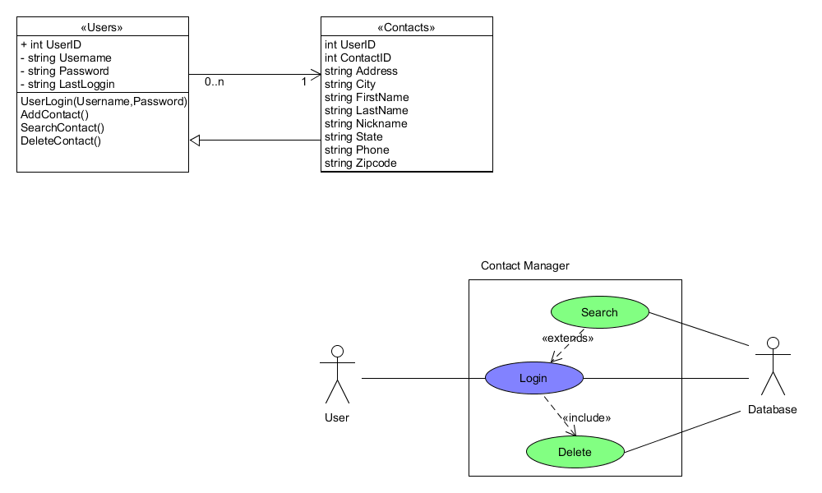
UML Diagrams

Slide 6
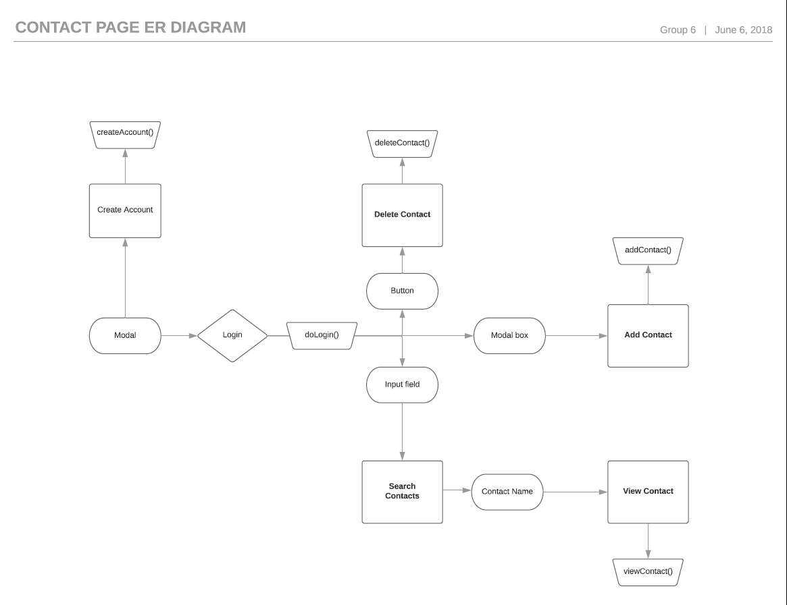
Entity Relation Diagram

Slide 7
Difficulties/Successes
Problems meeting the time set
Not enough communications throughout the project
Half of the team took on task that we don’t know
Completed the bases of the project ahead of time
Somewhat fully learned the new materials
Division of workload
Funcational Deliverable

Slide 8
Group Demo

